Slide 1
Paper Reading Report of:
AI Guide:
Game on & Beyond Games
MELANIE MITCHELL
Prepared by: Zhe HUANG

Slide 2



(1) PRESENTERS
Zhe HUANG

Slide 3
(2) TITLE & KEYWORDS
AI on games -> to real world?
Keywords: DeepMind, Reinforcement Learning, Atari Games, AlphaGO

Slide 4
(3) TOPIC
From Atari Games to AlphaGo, can AI go further in the future to really affect our life?

Slide 5
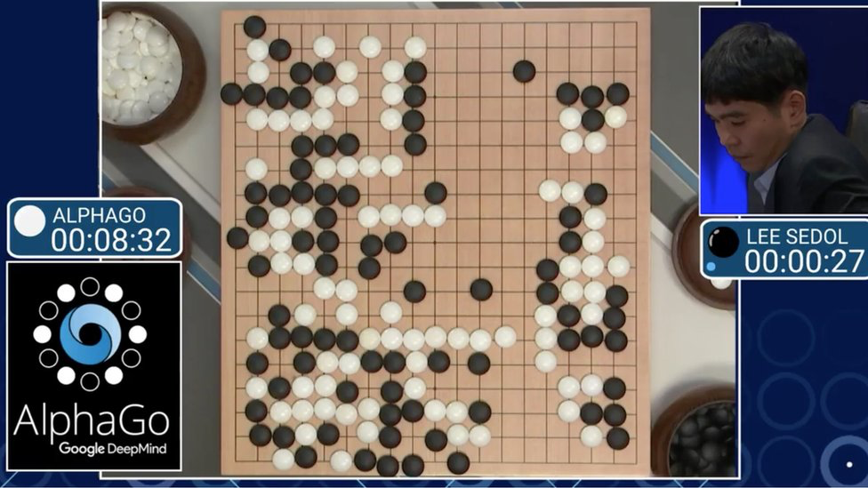
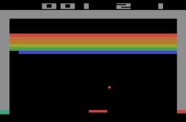
(4) IMPACT
DeepMind use AI to play video games and GO.
RL then became popular in past years!

Slide 6
(5) INTEREST
I like playing video games and chess too.
Game is a simple/naive model of the real world!
If AI on games is feasible, then we could try to apply AI to real world.

Slide 7
(6) Quote and people
“Games are just our development platform
…
The whole point is that it’s general AI—it’s learning how to do things based on its own experience and its own data.”
—Demis Hassabis(who created DeepMind)

Slide 8
(7) NOVELTY
Go, one of the most complex human games, was conquered, which demonstrates the potential of Deep Reinforcement Learning.
DeepMind combines DL and RL; DRL is one of the most popular theory in the past years.

Slide 9
(8) GENERALITY
Beyond games:
Self-driving vehicle;
Recommendation Algo;
Quantative Trading;

Slide 10
(9) TEST-OF-TIME
“Uber researchers kept trying new random-weight networks, and eventually (in less time than it took to train a Deep Q-Network) they found networks that performed nearly as well as or even better than networks trained by deep Q-learning on five out of the thirteen games they tested.”
“it’s possible that the Atari game domain is not as challenging for AI as people originally thought.”

Slide 11
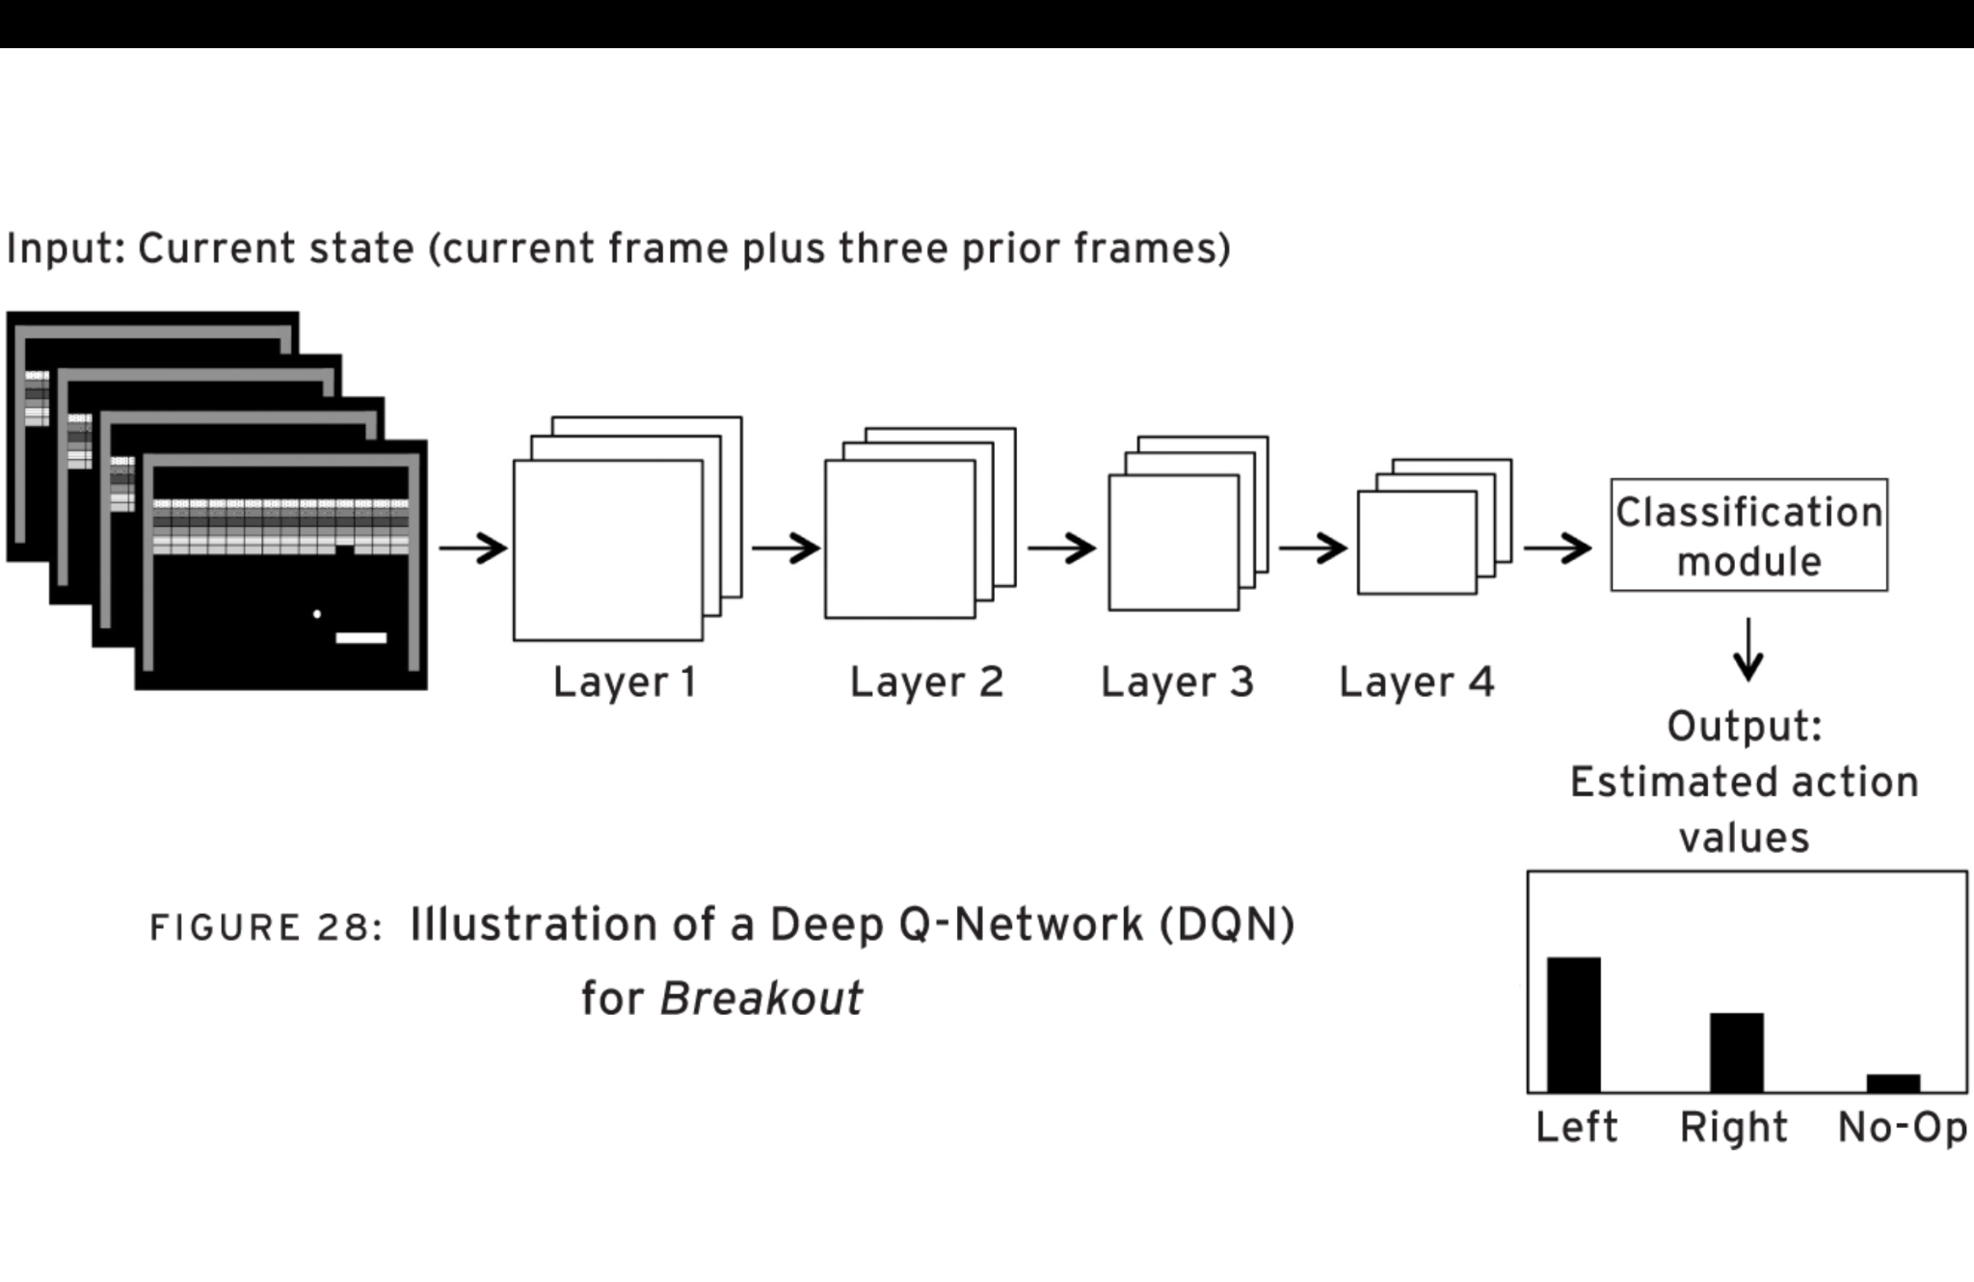
(10) FIGURE

Slide 12
(16) CLARITY
These two chapters mainly talk about how AI are used in the games and whether they can be applied to other things.
Complete and Interesting

Slide 13
(17) ETHICS
One critical point is that even AlphaGo performs well, it can never understand what Go is.
In other words, we need ‘transfer learning’ (ability of a program to transfer what it has learned about one task to a different, related task.)

Slide 14
(18) LEARNING
It’s really a genius idea to do RL research on Games;
RL is a little similar to the learning mode of humans, but it lacks ability of ‘transfer’.

Slide 15
(19) CONCLUSION
AI on games are brilliant, but there’s still a long way to go to apply AI on highly-complex and accuracy-needed scenes in real world.

Slide 16
(20) FURTHER WORK AND QUESTIONS FOR DISCUSSION
2019:AlphaStar for StarCraft
2022:AlphaCode for coding
What (do u think) is the future direction of AI?
Can DRL eventually evolve into mature AI?

